Slide 1
Quickstart: Migrate your database to Azure SQL Database
Will Eastbury
Technical Evangelist – ISV / Azure
London, 15th February 2017

Slide 2
In the beginning …
Notes:
How many people have migrated a db to SQL Database ?
How many have an intention to do so in the future ?
Where the hell do I start, what resources do I have available ?

Slide 3
Where do I start ?
Resources
Migration Cookbook: https://azure.microsoft.com/en-gb/blog/migration-cookbook-now-available-for-the-latest-azure-sql-database-update-v12/
Azure SQL Database Documentation: https://docs.microsoft.com/en-us/azure/sql-database/sql-database-technical-overview
Azure SQL Database DTU Calculator: http://dtucalculator.azurewebsites.net/
Migrating from non-SQL Server DB such as Oracle ?: https://blogs.msdn.microsoft.com/datamigration/2016/12/22/released-sql-server-migration-assistant-ssma-v7-2/
Tools
SQL Server Data Tools for Visual Studio (SSDT): https://msdn.microsoft.com/en-gb/mt186501
SQL Server Management Studio (SSMS): https://docs.microsoft.com/en-us/sql/ssms/download-sql-server-management-studio-ssms
Old: SQL Azure Migration Wizard http://sqlazuremw.codeplex.com/
New: Azure Data Migration Assistant: https://www.microsoft.com/en-us/download/details.aspx?id=53595
Try it!
TechNet Virtual Lab - https://vlabs.holsystems.com/vlabs/technet?eng=VLabs&auth=none&src=vlabs&altadd=true&labid=13209

Slide 4
BUT: You might not need any of this …
If your database is simple, (for example a store created in EF code first) it will probably just deploy.
If your database doesn’t use any non db features, it will probably just deploy.
Try it and see.

Slide 5
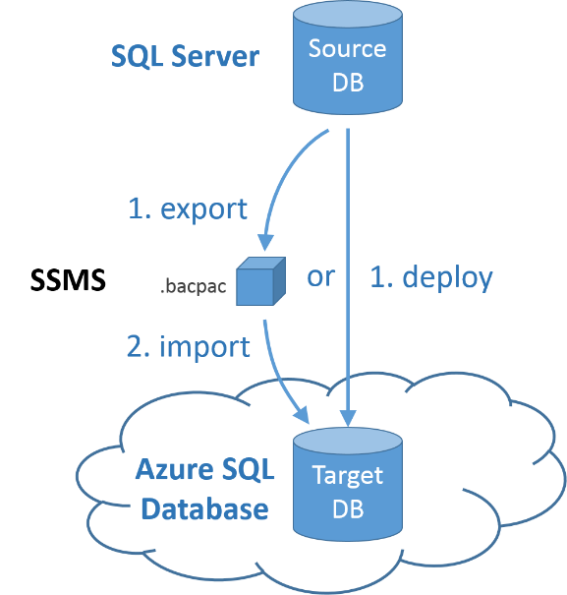
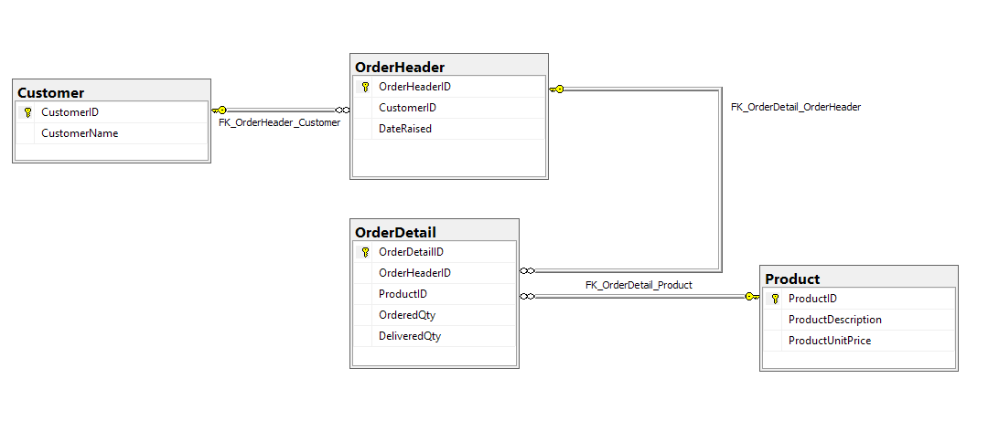
Demo: Simple Deploy
Notes:
Database Willsdemodb on server :-
Assess the database for compatibility using the latest version of Data Migration Assistant (DMA).
willsdemodbbluepeter
Export the database copy to a .BACPAC file on a local drive in SSMS.
Import the .BACPAC file as a new Azure SQL database using any of several BACPAC import tools, with SQLPackage.exe being the recommended tool for best performance.

Slide 6
What won’t work out of the box?

Slide 7
What won’t work out of the box?
•Collation of system objects
•Connection related: Endpoint statements, ORIGINAL_DB_NAME. SQL Database does not support Windows authentication, but does support the similar Azure Active Directory authentication. Some authentication types require the latest version of SSMS. For more information, see Connecting to SQL Database or SQL Data Warehouse By Using Azure Active Directory Authentication.
•Cross database queries using three or four part names. (Read-only cross-database queries are supported by using elastic database query.)
•Cross database ownership chaining, TRUSTWORTHY setting
•DATABASEPROPERTY Use DATABASEPROPERTYEX instead.
•EXECUTE AS LOGIN Use 'EXECUTE AS USER' instead.
•Encryption is supported except for extensible key management
•Eventing: events, event notifications, query notifications
•Syntax related to database file placement, size, and database files that are automatically managed by Microsoft Azure.
•Syntax related to high availability, which is managed through your Microsoft Azure account. This includes syntax for backup, restore, Always On, database mirroring, log shipping, recovery modes.
•Syntax that relies upon the log reader, which is not available on SQL Database: Push Replication, Change Data Capture. SQL Database can be a subscriber of a push replication article.
•Syntax that relies upon the SQL Server Agent or the MSDB database: alerts, operators, central management servers. Use scripting, such as Azure PowerShell instead.
•Functions: fn_get_sql, fn_virtualfilestats, fn_virtualservernodes
•Global temporary tables
•Syntax related to hardware-related server settings: memory, worker threads, CPU affinity, trace flags, etc. Use service levels instead.
•HAS_DBACCESS
•KILL STATS JOB
•OPENQUERY, OPENROWSET, OPENDATASOURCE, BULK INSERT, and four-part names
•.NET Framework CLR integration with SQL Server
•Semantic search
•Server credentials. Use database scoped credentials instead.
•Server-level items: Server roles, IS_SRVROLEMEMBER, sys.login_token. GRANT, REVOKE, and DENY of server level permissions are not available though some are replaced by database-level permissions. Some useful server-level DMVs have equivalent database-level DMVs.
•SET REMOTE_PROC_TRANSACTIONS
•SHUTDOWN
•sp_addmessage
•sp_configure options and RECONFIGURE. Some options are available using ALTER DATABASE SCOPED CONFIGURATION.
•sp_helpuser
•sp_migrate_user_to_contained
•SQL Server audit. Use SQL Database auditing instead.
•SQL Server trace
•Trace flags. Some trace flag items have been moved to compatibility modes.
•Transact-SQL debugging
•Triggers: Server-scoped or logon triggers
•USE statement: To change the database context to a different database, you must make a new connection to the new database.

Slide 8
In summary – these constructs are not supported
SQL Server Feature | Consider this Azure Feature instead
Change Data Capture | SQL Database Change Tracking / Triggers
SQLCLR | Azure Functions
AlwaysOn Availability Groups | SQL Database Active Geo-Replication
Database mail | Azure Functions / SendGrid
Database mirroring | SQL Database Active Geo-Replication
Data Quality Services | N/A
FILESTREAM | Azure Blob Storage
Linked Servers | SQL Database Elastic Query
Database snapshots | SQL Database Point in time restore
Data Replication | SQL Database Active Geo-Replication
Polybase | Azure SQL Data Warehouse, Azure SQL Database Elastic Scale / Query
Extended stored procedures | Azure Functions / Azure Automation
Service broker | Azure Service Bus / Azure Functions
SQL Server Agent | Azure Automation / Azure Functions
Windows authentication | SQL Database Azure Active Directory Authentication
Non Database Engine Features (SSAS, SSRS, SSIS) | Azure Analysis Services, Power BI Embedded, Azure Data Factory

Slide 9
Authentication in Azure SQL Database
NO Windows authentication
Authenticate with either Azure AD Authentication or SQL Authentication
Consider impact to replication of databases by using partially contained databases for user identities.
i.e. Put contained users into the database and / or map these to Azure AD identities.
https://msdn.microsoft.com/en-us/library/ff929188.aspx
https://docs.microsoft.com/en-us/azure/sql-database/sql-database-control-access-sql-authentication-get-started
https://docs.microsoft.com/en-gb/azure/sql-database/sql-database-aad-authentication

Slide 10
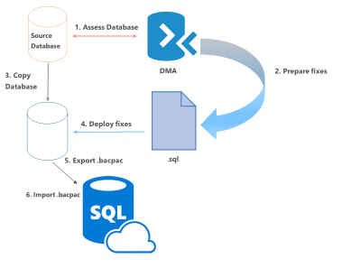
Demo: Data Migration Assistant
Notes:
Assess the database for compatibility using the latest version of Data Migration Assistant (DMA).
Prepare any necessary fixes as Transact-SQL scripts.
Make a transactionally consistent copy of the source database being migrated - and ensure no further changes are being made to the source database (or you can manually apply any such changes after the migration completes). There are many methods to quiesce a database, from disabling client connectivity to creating a database snapshot.
Deploy the Transact-SQL scripts to apply the fixes to the database copy.
Export the database copy to a .BACPAC file on a local drive.
Import the .BACPAC file as a new Azure SQL database using any of several BACPAC import tools, with SQLPackage.exe being the recommended tool for best performance.

Slide 11
Other Method
Use Transactional Replication
Notes:
Method 2: Use Transactional Replication
When you cannot afford to remove your SQL Server database from production while the migration is occurring, you can use SQL Server transactional replication as your migration solution.
To use this method, the source database must meet the requirements for transactional replication and be compatible for Azure SQL Database. +
To use this solution, you configure your Azure SQL Database as a subscriber to the SQL Server instance that you wish to migrate.
The transactional replication distributor synchronizes data from the database to be synchronized (the publisher) while new transactions continue occur. +
With transactional replication, all changes to your data or schema show up in your Azure SQL Database.
Once the synchronization is complete and you are ready to migrate, change the connection string of your applications to point them to your Azure SQL Database.
Once transactional replication drains any changes left on your source database and all your applications point to Azure DB, you can uninstall transactional replication. Your Azure SQL Database is now your production system.
You can also use transactional replication to migrate a subset of your source database. The publication that you replicate to Azure SQL Database can be limited to a subset of the tables in the database being replicated. For each table being replicated, you can limit the data to a subset of the rows and/or a subset of the columns.
Set up Distribution
Using SQL Server Management Studio (SSMS)
Using Transact-SQL
Create Publication
Using SQL Server Management Studio (SSMS)
Using Transact-SQL
Create Subscription
Using SQL Server Management Studio (SSMS)
Using Transact-SQL

Slide 12
Demo: Quick replacement for Db Mail and any agent task. {with Azure Functions and SendGrid}
Notes:
Based on the example found at https://docs.microsoft.com/en-us/azure/azure-functions/functions-scenario-database-table-cleanup
Add a connection string setting in the function app called sqlconn <REDACTED>
Get it from the portal … Database > All settings > Properties > Show database connection strings > ADO.NET (SQL authentication).
Also create a SendGridAPIKey entry with <REDACTED>
Create a timer-triggered function from the template
And add the following code…
#r "System.Configuration"
#r "System.Data"
#r "SendGrid"
using System;
using System.Configuration;
using System.Data.SqlClient;
using SendGrid.Helpers.Mail;
public static void Run(TimerInfo myTimer, TraceWriter log, out Mail message)
{
var str = ConfigurationManager.ConnectionStrings["sqlconn"].ConnectionString;
using (SqlConnection conn = new SqlConnection(str))
{
conn.Open();
var text = "SELECT OrderHeaderID FROM dbo.vm_NextOrderToShip (nolock)";
using (SqlCommand cmd = new SqlCommand(text, conn)) {
int nextOrderHeaderID = (int) cmd.ExecuteScalar();
log.Info($"Need to ship order {nextOrderHeaderID}");
var messageContent = new Content("text/html", $"Ship this order next: {nextOrderHeaderID.ToString()}.");
var personalization1 = new Personalization();
personalization1.AddTo(new Email("william.eastbury@microsoft.com"));
message = new Mail();
message.AddContent(messageContent);
message.AddPersonalization(personalization1);
log.Info($"Email complete for order {nextOrderHeaderID}");
}
}
}

Slide 13
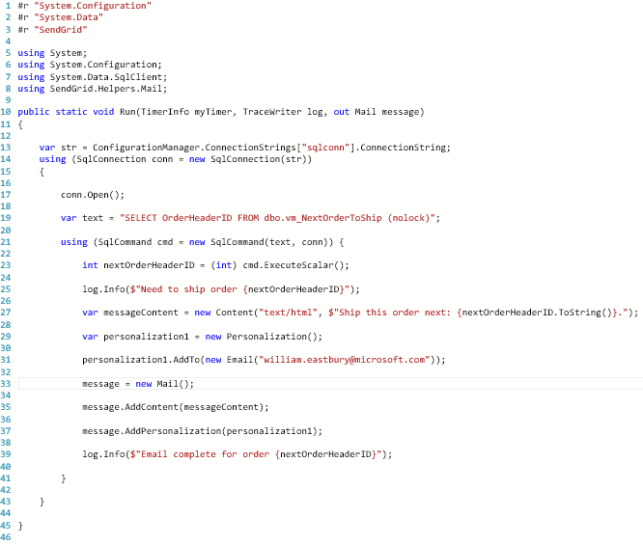
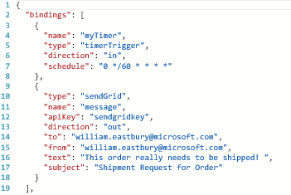
Code for our DB Mail function

